Slide 1


Deep Hedging: Learning to Manage Risk Beyond Black-Scholes
Classical hedging models, such as Black-Scholes, provide a rigid, analytic solution that often fails in realistic, non-ideal market conditions. These conditions include noisy, discrete trading environments with significant transaction costs.
Neural Networks for Policy
Realistic Risk Management
Deep Hedging replaces fixed formulas with a neural network that dynamically learns the optimal hedging strategy.
The model is trained to minimize downside risk directly under realistic market frictions and non-continuous trading.
AI Agent Integration
This project implements and extends the framework, integrating it into our Options Risk Assessment AI Agent pipeline.

Slide 2

The Problem: Hedging Real-World Frictions
Why Traditional Hedging Fails
The Black-Scholes delta hedge relies on idealized assumptions (perfect liquidity, zero cost, constant volatility) that are never met in practice. This leads to severe model mismatch and misleading risk estimates when trading is discrete and expensive.
"How can we hedge financial risk realistically when trading is discrete and expensive?"
Traditional Approach Limitations
Deep Hedging Goal
Requires continuous re-hedging (impossible).
To train a neural policy that directly minimizes a non-linear, downside risk measure (e.g., CVaR) on the resulting Profit & Loss (P&L) distribution under realistic market frictions.
Assumes perfect market liquidity.
Ignores transaction costs and slippage.

Slide 3
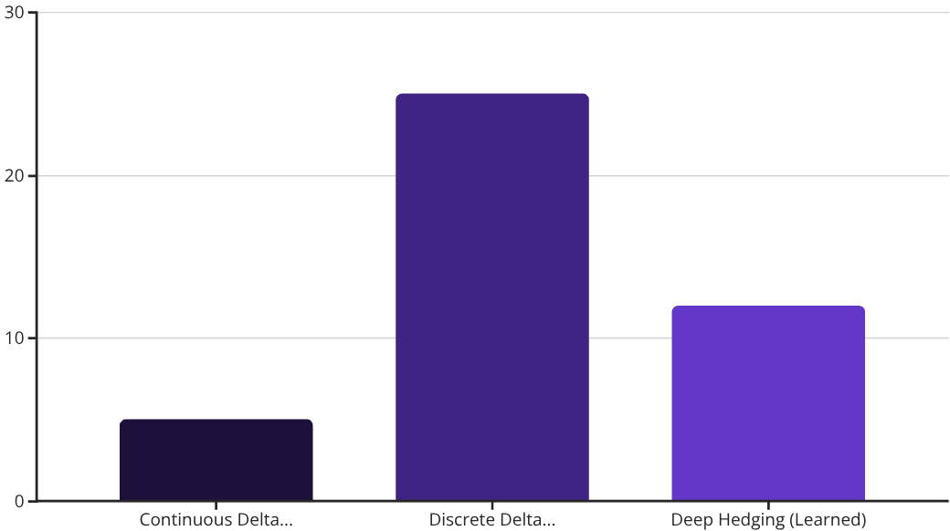
Why We Need a Data-Driven Policy
The core issue with the Black-Scholes model is its reliance on restrictive assumptions that break down immediately in a live trading environment. These theoretical constraints force unrealistic re-hedging strategies that incur high costs and systemic errors.
Key Black-Scholes Assumptions
Continuous Re-hedging
The foundation of the Delta is an infinitesimal time step, requiring constant re-balancing.
Constant Volatility
Implies the market is stable and predictable, ignoring stochastic volatility processes (like Heston).
The chart illustrates how real-world discrete hedging dramatically increases losses compared to the theoretical ideal, while Deep Hedging minimizes this gap by adapting to frictions.
Zero Transaction Costs
Assumes perfect market execution with no cost to enter or exit a position.
Log-Normal Prices
Price evolution is assumed to follow a geometric Brownian motion.

Slide 4
Core Objective: The Optimal Hedging Policy
The Deep Hedging framework aims to define and compute an optimal hedging policy \delta_t that minimizes a user-defined risk measure \rho over the final Profit & Loss distribution.
Convex Risk Measures
Market Model Setup
Select a robust risk measure (\rho), such as Conditional Value at Risk (CVaR) or Entropic Risk, to focus on tail losses.
Define the stochastic process for tradable assets (Sₜ) and the liability payoff (X).
Experimental Validation
Neural Policy Learning
Conduct rigorous simulation experiments, particularly using the Heston model for stochastic volatility.
Train the network to output the optimal hedge ratio based on market features and previous actions.
The objective is to find the policy \delta that minimizes the risk \rho of the final P&L, considering the liability X, asset value S, and cumulative transaction costs C.

Slide 5

Architecture for the Deep Hedging Pipeline
The system is structured into four distinct layers, each handling a specific part of the simulation, learning, and evaluation process.
Risk Layer
Market Layer
Learning Layer
Trade Update
Market Layer
Simulates or loads market price paths, defines liabilities (X), and tracks transaction costs (Cₜ).
Heston stochastic volatility model implementation.
Risk Layer
Applies the chosen convex risk measure \rho to the policy's P&L distribution.
Conditional Value at Risk (CVaR) or Entropic Risk objective function.
Learning Layer
The neural network learns the optimal policy \delta_t = f_\theta(\text{features}_t) through backpropagation.
Gated Recurrent Unit (GRU) policy or a standard Multi-Layer Perceptron (MLP).
Evaluation Layer
Quantifies policy performance against a baseline (e.g., Black-Scholes Delta hedge).
P&L distribution histograms and CVaR sensitivity curves.

Slide 6



Market Setup: Defining P&L Under Frictions
The market layer is responsible for rolling out the agent's policy \delta_t across a simulated price path S_t and computing the resulting P&L, explicitly accounting for transaction costs C_t.
Asset Dynamics (Sₜ)
Liability (X)
Transaction Costs (Cₜ)
The evolution of the tradable asset price over the time horizon T.
The cash flow (payoff) obligation from the instrument being hedged (e.g., sold European Call option).
A function of the change in position size, representing realistic trading costs (e.g., proportional to trade volume).
The final P&L is calculated based on the terminal cash balance, the value of the final position, and the original liability:
def rollout_policy(policy, S_paths, K, cost_rate, r, dt): cash = torch.zeros(N, device=S_paths.device) delta_prev = torch.zeros(N, device=S_paths.device) for k in range(T): S_t = S_paths[:,k] tau_norm = torch.full_like(S_t, (T-k)/T) delta_t = policy(S_t, tau_norm, delta_prev) trade_cost = cost_rate * (delta_t - delta_prev).abs() * S_t cash -= (delta_t - delta_prev) * S_t + trade_cost delta_prev = delta_t payoff = torch.clamp(S_paths[:,-1] - K, min=0) return cash + delta_prev*S_paths[:,-1] - payoff

Slide 7
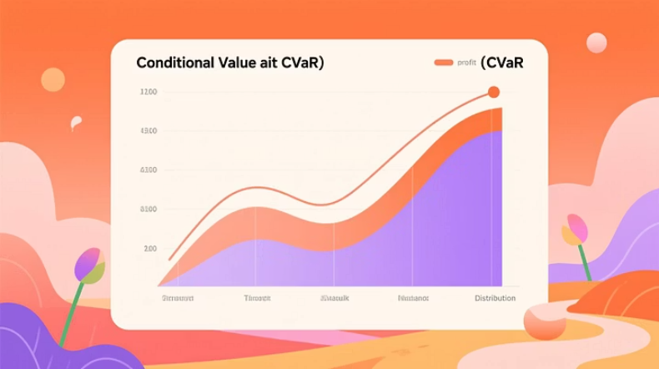
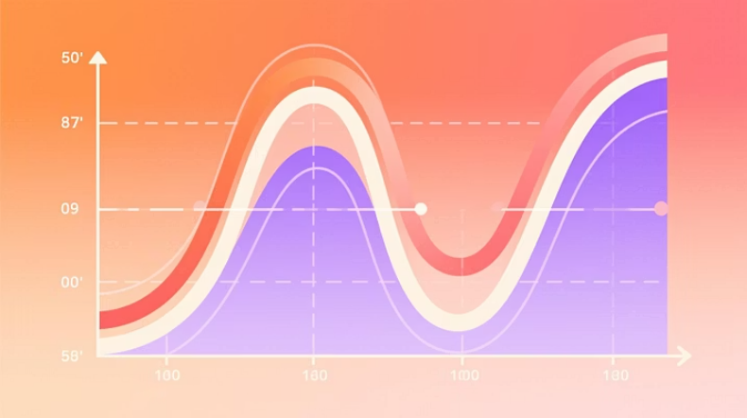
Risk Measurement: Focusing on the Tail
Instead of optimizing for expected return, Deep Hedging optimizes for a convex risk measure \rho, which assigns a higher penalty to adverse outcomes, forcing the policy to focus on minimizing tail losses.
Conditional Value at Risk (CVaR)
The average of the worst \alpha% of P&L outcomes (e.g., \alpha=5\%).
-torch.mean(sorted_pnl[:int(\alpha*N)]) - Minimizing this maximizes the average return in the worst scenarios.
Entropic Risk
A smooth, exponentially weighted average P&L, representing a highly risk-averse expectation.
\gamma \log E[e^{-X/\gamma}] - Preferred for smooth optimization convergence during training.
def cvar_loss(pnl, alpha=0.05): s,_ = torch.sort(pnl) k = int(alpha * len(s)) return -s[:k].mean()def entropic_risk(pnl, gamma): x = -pnl / gamma m = x.max().detach() return gamma * (torch.log(torch.exp(x - m).mean()) + m)

Slide 8

The Learning Component: Neural Policy
The core of Deep Hedging is replacing the analytic delta with a neural network that learns the optimal hedge ratio \delta_t by processing real-time market features and previous actions.
Neural Network Inputs
GRU Policy Implementation
class HedgePolicyGRU(nn.Module): def __init__(self, hidden=128, num_instr=2): super().__init__() self.gru = nn.GRU(input_size=3, hidden_size=hidden, batch_first=True) self.head = nn.Linear(hidden, num_instr) def forward(self, seq): h,_ = self.gru(seq) return self.head(h)
Price (Sₜ)
The current price of the underlying asset.
Volatility (\sqrt{v_t})
The current instantaneous volatility (if using a stochastic model like Heston).
Time-to-Expiry (\tau_t)
Normalized time remaining until the option expires.
Previous Hedge (\delta_{t-1})
The position held in the previous time step, crucial for cost calculation.

Slide 9
The Monte Carlo Training Loop
The training procedure leverages Monte Carlo simulation to generate a diverse set of market scenarios (paths) and calculates the gradient of the risk objective function back through the rollout and the neural policy.
1. Simulate Paths
2. Rollout Policy
Generate asset paths (S, v) for an entire batch using the Heston model or other processes.
Execute the current policy \delta_\theta along all paths to compute the final P&L distribution.
3. Evaluate Risk
4. Update Parameters
Calculate the loss \rho(\text{P\&L}) (e.g., Entropic Risk) to capture the magnitude of tail events.
Use backpropagation (Adam optimizer) through the entire differentiable process to update \theta.
for epoch in range(epochs): S,v = simulate_heston(batch_size) pnl = rollout(policy, S, v) loss = entropic_risk(pnl, v) opt.zero_grad(); loss.backward(); opt.step()

Slide 10
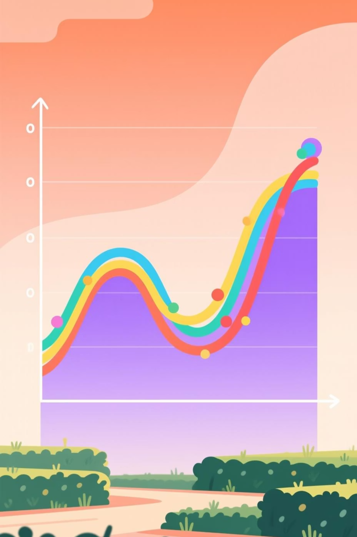
Training Curve: Risk Reduction Dynamics
Risk Metric
Significant Drop
Entropic Risk (\rho) used as convex measure.
Risk reduces sharply from ≈ 120 down to ≈ 8.
Convergence
Model stabilizes around epoch 150, achieving a stable, risk-minimized policy.
This demonstrates the network's ability to minimize tail risk during scenario-based training.

Slide 11

Out-of-Sample P&L Distribution: Superior Risk Control
Interpretation
Narrower Distribution: Deep Hedging NN reduces P&L variance.
Downside Compression: Fewer large negative P&L events (tail risk minimized).
Cost-Aware: Achieves superior risk control, matching claims on cost-aware hedging.
The Deep Hedging policy actively learns to avoid high-cost, high-variance trades.
Notes:
The key takeaway from this slide is that the Deep Hedging neural network approach reduces the overall P&L variance and minimizes downside tail risk compared to other hedging methods.
The narrower P&L distribution indicates the Deep Hedging model is able to control risk more effectively, generating a more consistent and predictable P&L.
The reduction in large negative P&L events shows the model is successful at avoiding high-cost, high-variance trades that can lead to significant losses.
This cost-aware risk control aligns with the goals of effective hedging, providing superior risk management compared to traditional approaches.
The callout box emphasizes that the Deep Hedging policy actively learns to avoid these high-risk, high-cost trades, further enhancing its risk control capabilities.

Slide 12
Deep Hedging vs. Black-Scholes Delta (Benchmark)
Quantifying the effectiveness of the learned hedging policy over the traditional analytical approach.
Deep Hedging (GRU, Stock + Call)
-8.02
0.79
8.68
Baseline (BS \Delta, Stock only)
-7.81
2.19
12.99
Tail Risk Reduction
Lower Trading Cost
Deep Hedging reduces CVaR (tail risk) by approximately 33%.
The learned policy trades less frequently, resulting in lower transaction costs.

Slide 13
Risk–Return Frontier: Tunable Risk Aversion
The Role of the \gamma Parameter
Smaller \gamma
Larger \gamma
Policy Tuning
More risk-averse behavior. Tighter tail loss control but slightly lower mean P&L.
Approaches risk-neutrality. Increased variance and potentially higher tail losses.
The frontier allows calibration of the hedge policy for specific institutional risk mandates.

Slide 14

Hedge Behaviour: Smoother \delta_t Trajectories
BS \Delta Trajectory
Trained \delta_t Policy
Realism Under Friction
Oscillates wildly. Implies continuous rebalancing, which is unrealistic under friction.
Significantly smoother. Trades only when the entropic risk justifies the transaction cost.
The deep hedging policy naturally incorporates cost awareness into its decision process.

Slide 15
Key Findings: Validation and Replication
Risk Decreases with Epochs
Tail Loss Reduction (CVaR)
Paper: Entropic \rho showed convergence.Demo: Replicated curve (122 \rightarrow 8).
Paper: NN CVaR < BS \Delta CVaR.Demo: 8.68 < 12.99 (Significant difference).
Lower Trading Frequency
Portfolio Extension
Paper: Network self-regularizes.Demo: Smoothed and less frequent \delta_t adjustments.
Paper: Multi-asset scalability.Demo: Successfully hedged Stock + Call option portfolio.

Slide 16
Integration into Our AI Quant Pipeline
Applying the Deep Hedging model as the core "risk minimization brain" in our system.
ETL / Data Layer
1
Load daily options chain data (Yahoo / Polygon) into Snowflake (RAW \rightarrow CURATED).
2
Feature Engineering
Compute Greeks (\Delta, \Gamma, \Theta, \nu), time-to-expiry, IV trend, and liquidity metrics.
Agentic Layer (Deep Hedging)
3
GRU model trained on simulated scenarios or historical data to learn optimal hedging policy.
4
Output & Risk Management
Real-time risk alerts (CVaR, Expected Shortfall) and executable hedge recommendations.

Slide 17

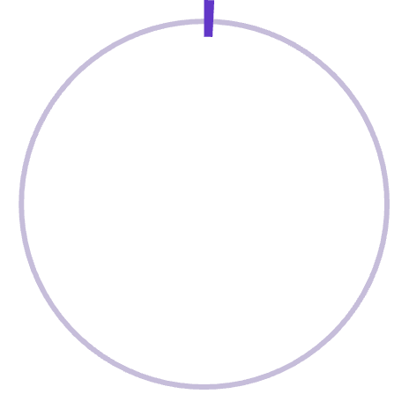
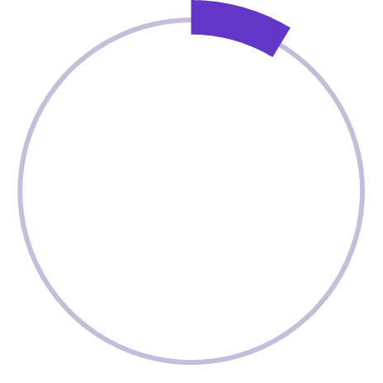
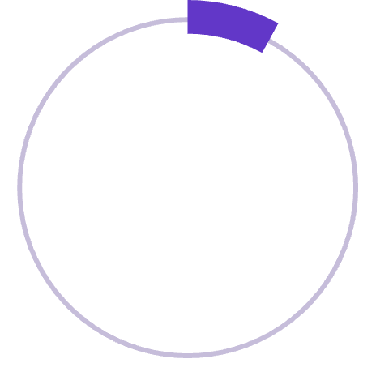
Summary of Comparative Results
0.79
8.68
P&L Standard Deviation
5% CVaR (Tail Risk)
NN: 0.79 vs. BS \Delta: 2.19. Significant reduction in outcome variance.
NN: 8.68 vs. BS \Delta: 12.99. Tail losses reduced by ~33%.
-8.02
Mean P&L
NN: -8.02 vs. BS \Delta: -7.81. Minimal mean reduction—the price of stability.
Interpretation
The Deep Hedging policy is inherently risk-aware and cost-sensitive, delivering stability and predictability by minimizing tail risk and trading friction.

Slide 18
Concepts Validated and Key Learnings
Neural Approximations
Convex Risk Measures
Monte-Carlo Training
Replaced rigid analytical hedges with flexible, data-driven NN policies.
Applied sophisticated risk metrics (CVaR, Entropic \rho) for training objective.
Successfully implemented scenario-based training for the hedging policy network.
Out-of-Sample Validation
AI Risk Pipeline
Rigorous testing confirmed robustness and performance on unseen data.
Demonstrated practical integration into a modern AI risk management framework.

Slide 19
Conclusion: Deep Hedging for Modern Finance
Scalability
Applicable to multi-asset portfolios and complex risk definitions.
Risk-Averse Learning
Learns optimal, cost-aware policy without relying on closed-form solutions.
AI in Quant Finance
Deep Hedging is a powerful paradigm shift in derivatives risk management.
Bridging academic theory with practical, agentic AI solutions in data engineering.

